Slide 1
MOSFET Based ECG Signal Acquisition System Design
By Ujjawal Agrawal (19095099)
Under the supervision of Dr. Somak Bhattacharyya

Slide 2

CARDIOVASCULAR DISEASE
Cardiovascular disease is a threat to human life.
According to statista 28.1% of total deaths in India are due to the cardiovascular diseases.
ECG signal can be used to make early prediction and diagnose of these diseses.
Most time, ECG signals converted to digital are used for analysis.

Slide 3
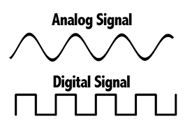
Why Digital
Digital signals allow -
High signal processing capabilities
Easy storage, transmission and retrieval of information.
Most equipments are digital due to their high­quality and flexibility of working with their output.

Slide 4
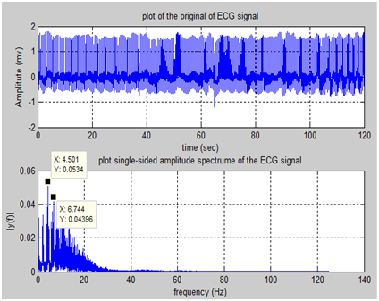
ECG Signals
The ECG signal is a bipolar low-frequency weak signal.
ECG signal frequencies vary in the range of 0.05-100Hz, mainly concentrate in the range of 0.05~ 25Hz.
Their amplitude ranges from 10 μ V to 5mV whose typical value is 1mV.

Slide 5
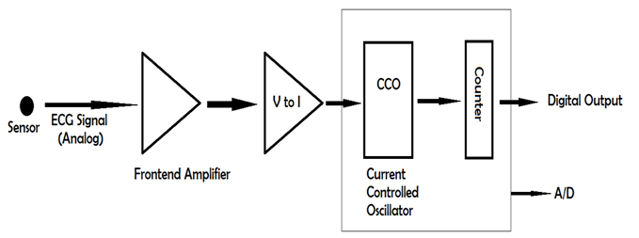
Overview of ECG signal acquisition circuit
The ECG signal acquisition system includes-
Input sensor (to get ECG signal from human body)
Frontend Amplifier (to amplify the input signal of milivolts to few volts),
Voltage to Current converter
Current Controlled Oscillator (whose frequency depends on input current)
Counter (which counts the number of waves in a particular time interval)
ADC (Analog to Digital Converter)

Slide 6
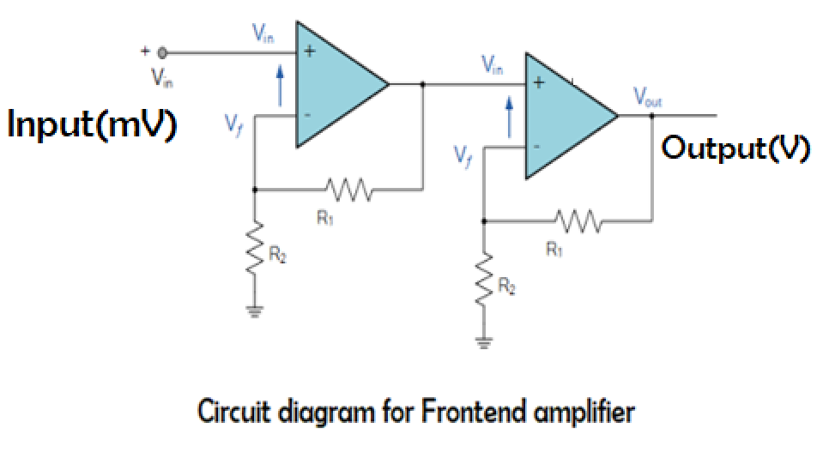
[1]- FRONTEND AMPLIFIER-
The gain of one amplifier, A= [1+(R1/R2)] So, A = 31 {approx.}
So, overall gain of our amplifier is-
A1*A2 = 960 {approx.}

Slide 7
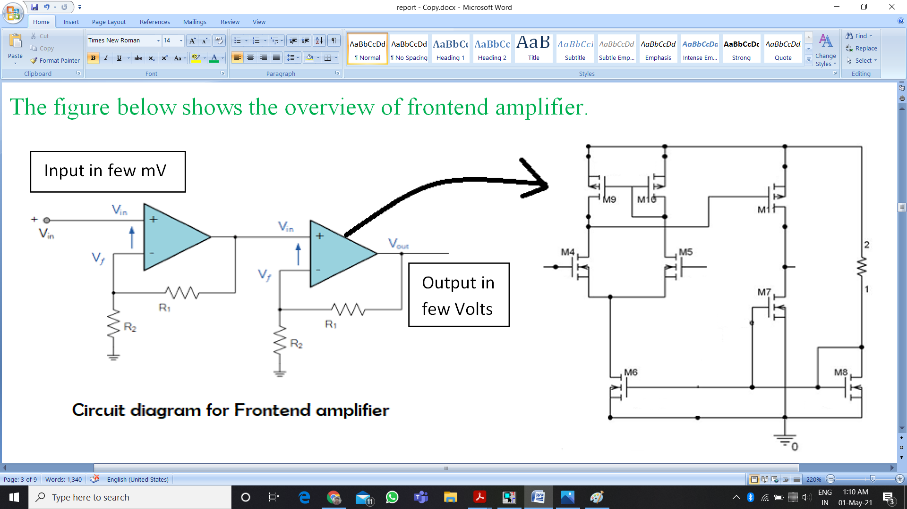
OP-AMP STRUCTURE (Differential pair MOSFET)
Notes:
1st stage is differential amplifier.
2nd stage is common source amplifier.
Below two mosfets act as current source.

Slide 8
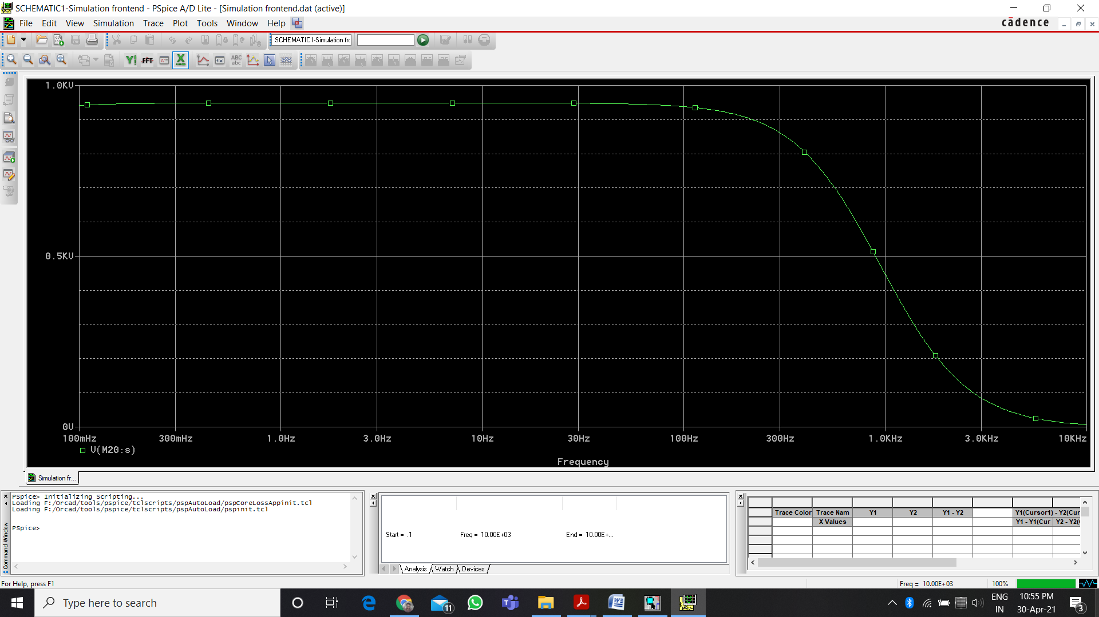
Bandwidth Analysis
The gain of the amplifier should be constant for all the frequencies of input signal. (ECG frequency is less than 100Hz)
Miller Compensation used.
Act as LPF.
BANDWIDTH GRAPH
Notes:
It removes the higher frequencies.

Slide 9
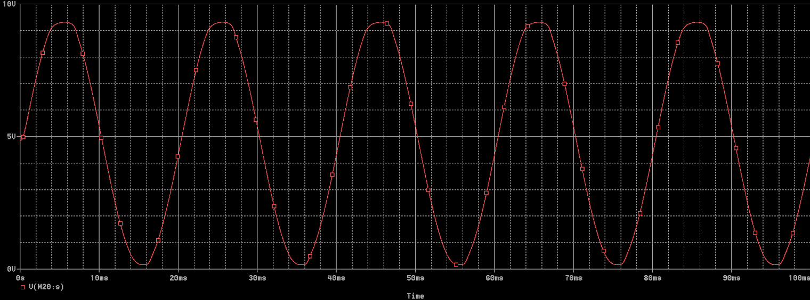
OUTPUT OF AMPLIFIER
If Input is a sin function of Amplitude 5mV.

Slide 10
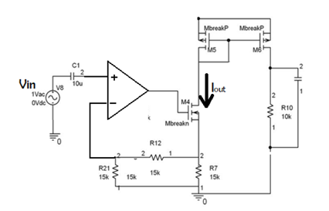
[2]- VOLTAGE TO CURRENT CONVERTER-
We are using CCO, so amplified voltage should be converted to current.

Slide 11
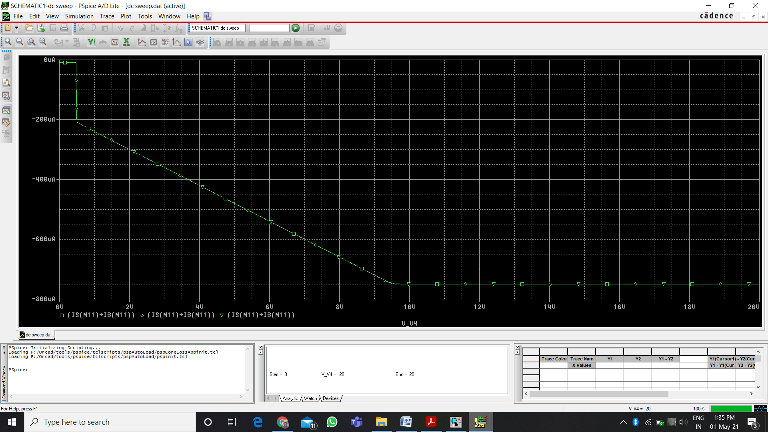
Iout vs Vin
Input range- (0.5-9.5) V
Output range- (200-750) uA
Note- Output swing of Amplifier and Input swing of V to I Converter should match.

Slide 12
[3]- CCO based Analog to Digital Converter (A/D)-
We will use a CCO and then we will count the number of pulses in a fix time interval (sampling period) .
Calculating Sampling Frequency:
According to Nyquist criterion, the sampling frequency should be at least twice the highest frequency contained in the signal.
We know that ECG signal is mostly concentrate in 0.05-25Hz. Therefore-
Sampling frequency = 2 X 25Hz = 50Hz
So, Sampling Period = (1/sampling frequency) = 0.02 Seconds

Slide 13
[3.1]- Current Controlled Oscillator (CCO)-
We are using oscillator, based on linear charging and discharging of a capacitor.
Why not Ring Oscillator ? [Transfer characteristic are highly non-linear and depend on Temperature].
The Frequency (f) of this Oscillator is given by-
f = [Current (input) / (2C.Vref)]
Thus ‘f’ is directly proportional to input current.

Slide 14
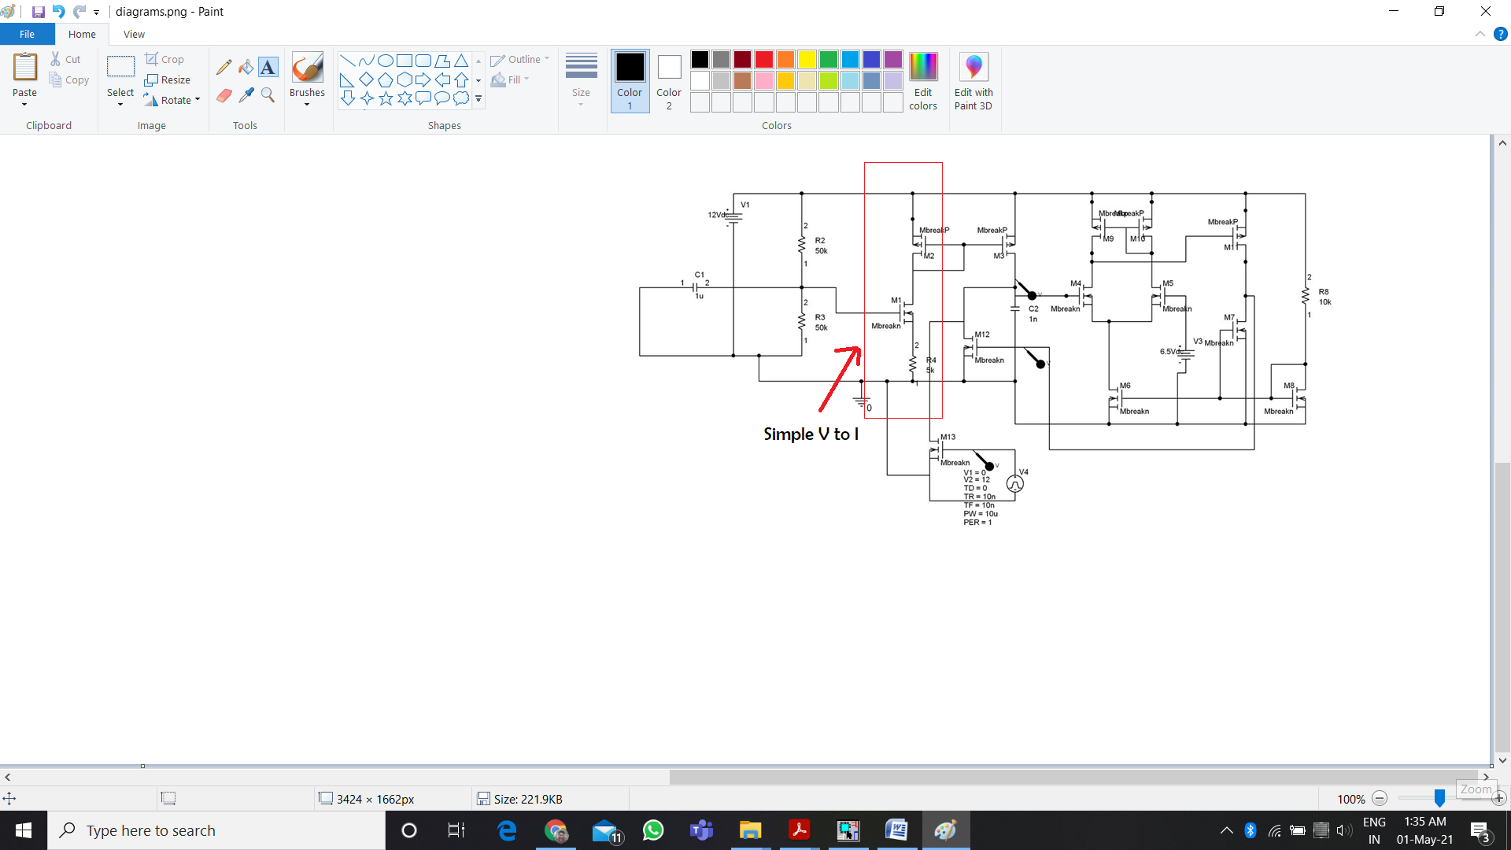
CCO Circuit

Slide 15
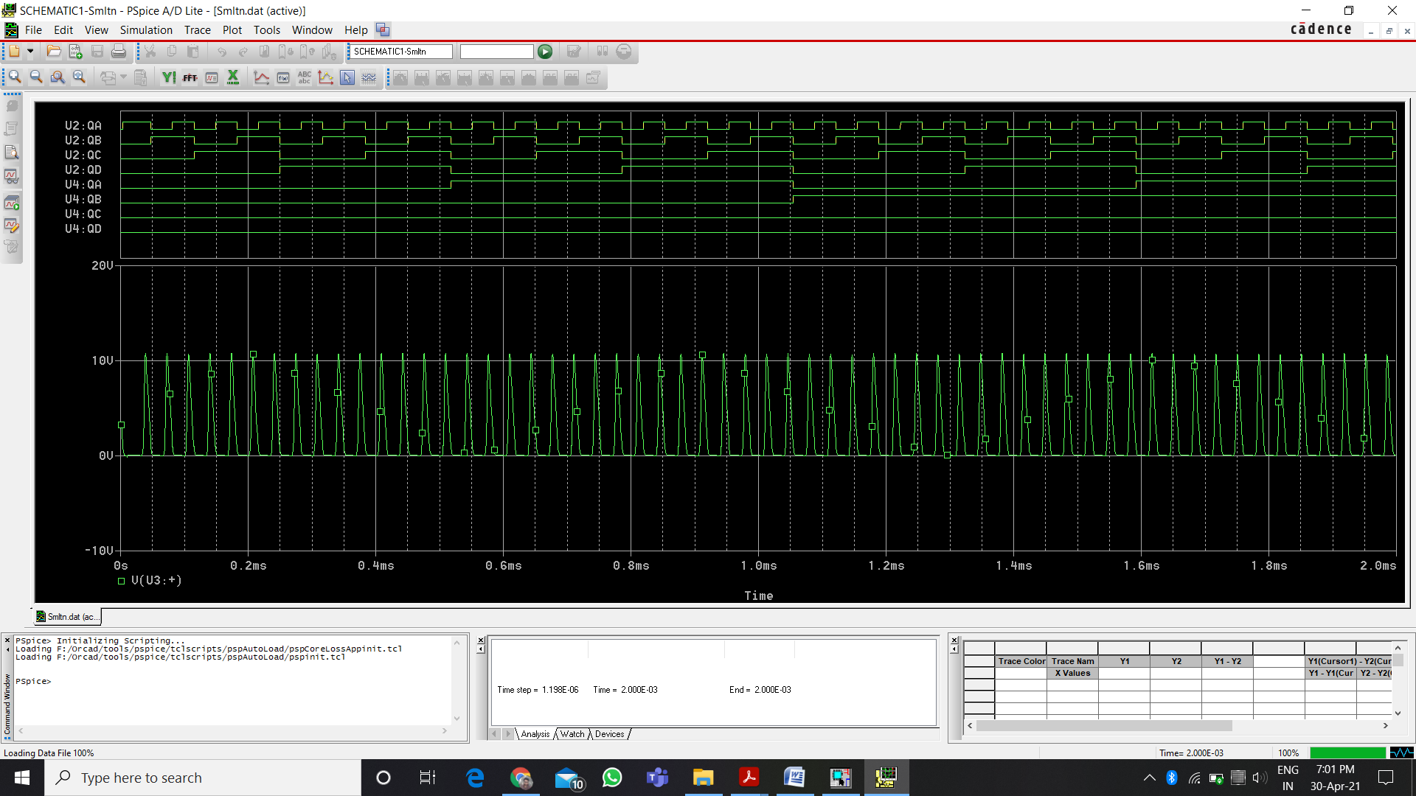
CCO Output

Slide 16
[3.2]- Counter-
The output of counter for input current, I = 524uA is shown below.
U4 : QD is MSB and U2 : QA is LSB.
LSB
MSB
The output of counter is 60 in 0.002 seconds. So the oscillator creates 60 pulses in 2ms or we can say 600 pulses in 0.02 sec (sampling period). And this is the digital value for our input ECG signal in this sampling period.

Slide 17
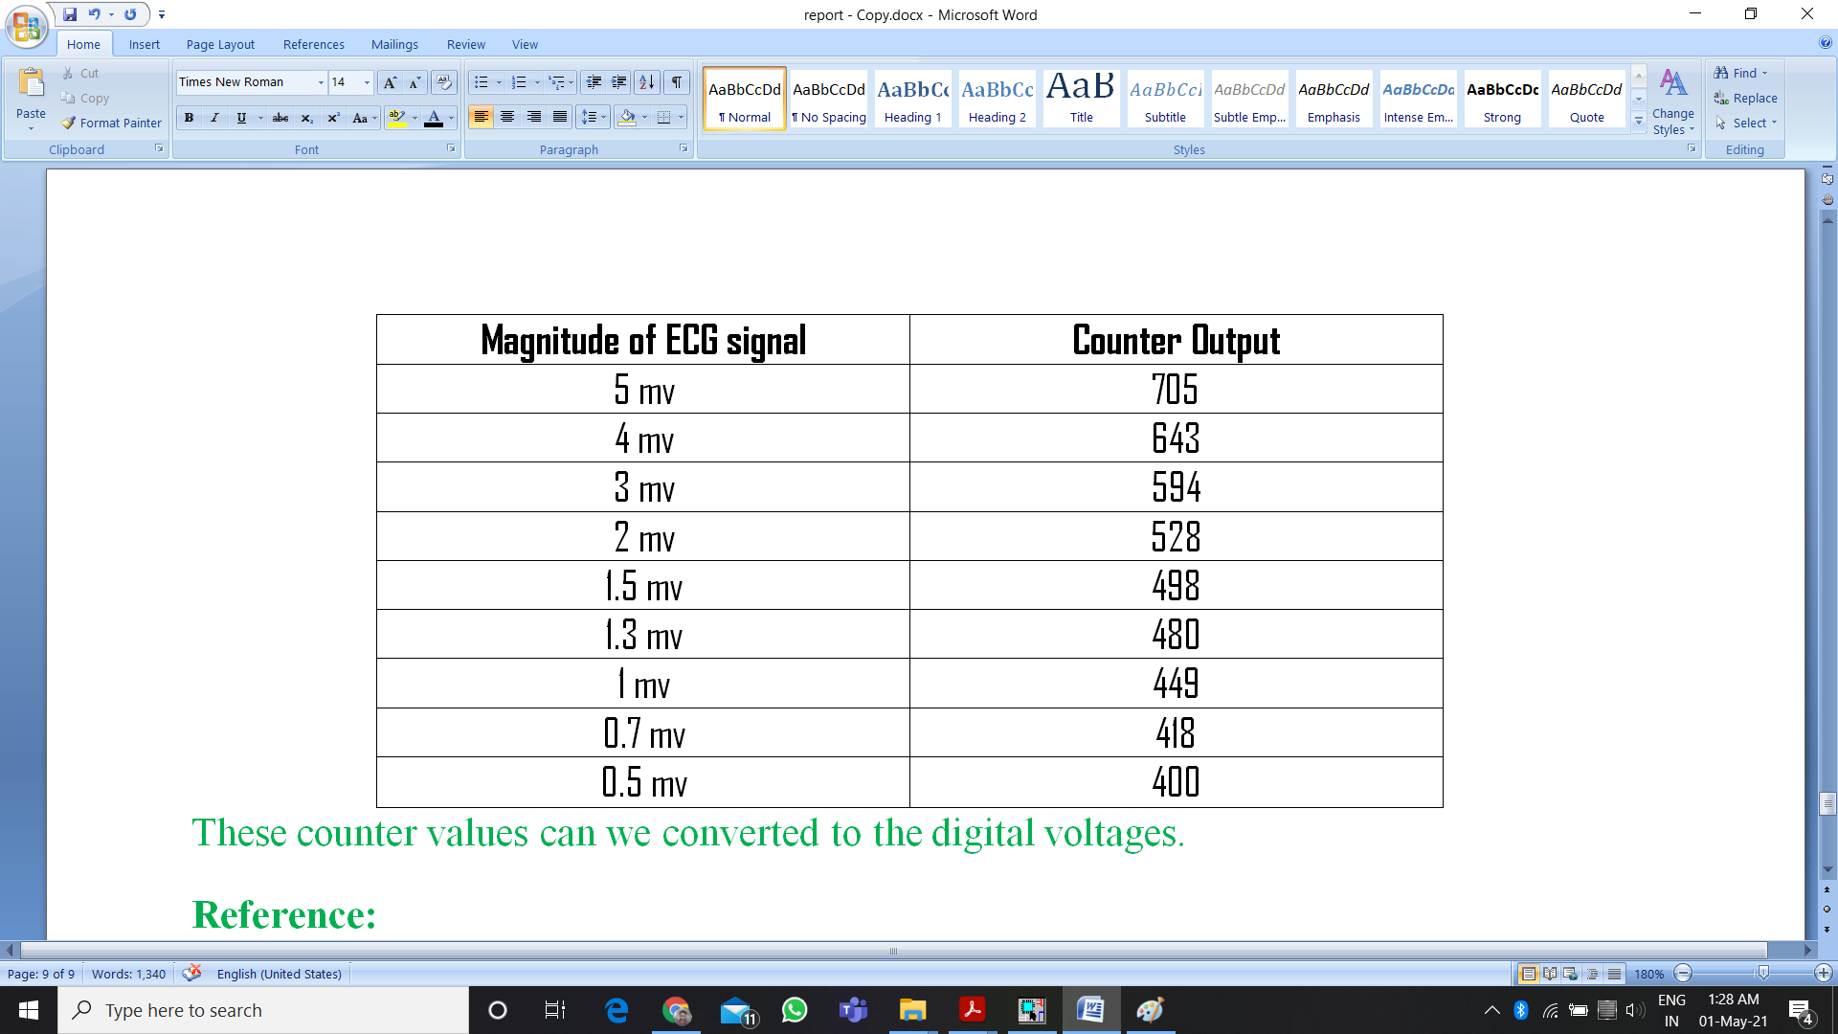
RESULT
By taking some magnitude of ECG signal, we have find the corresponding counter output.

Slide 18
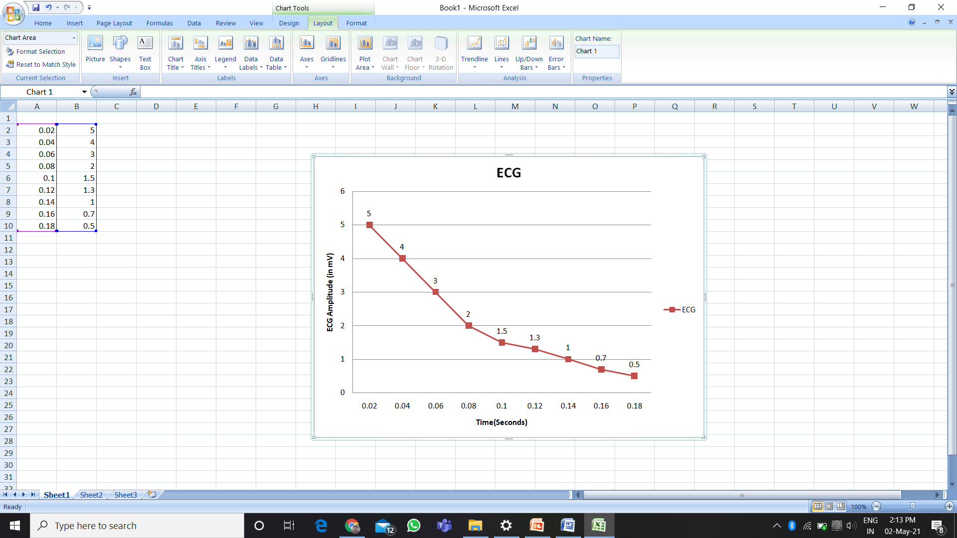
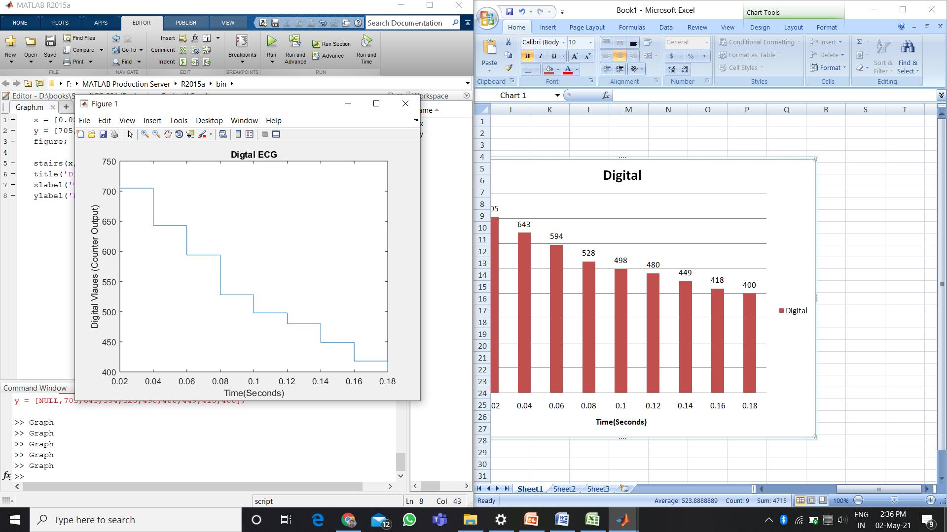
PLOTS
Input ECG Signal
Output Digital ECG Signal

Slide 19


